Slide 1

Parallel Project
Team Members
Esraa Mohammed Khalaf
Omnia Ibrahem Abdelazem
Gehad Nasser El_Dien Rabia
Wedad Ibrahem Haroun
Mervat Shahat Hassan
Hager Abdelazem Bakrey
Supervisors
Eng. Mahmoud Mohammad.
Eng. Rehab Mahmoud.

Slide 2
Parallel Prime Number Finding
Trial division is slow with O(sqrt(n)) complexity. Parallel Sieve of Eratosthenes divides the range among processors.
Using 16 cores can achieve a 15x faster prime calculation. However, workload balancing and communication are challenges.
Serial Method
Parallel Method
Trial division tests each number up to sqrt(n), sequentially.
Range partitioned across cores running sieve steps simultaneously.

Slide 3
Steps OF Parallel Prime Number Finding
Input Distribution: The main process reads a list of numbers from a file. It then divides these numbers into roughly equal chunks and sends each chunk to a different process.
Local Checking: Each process receives its chunk of numbers and checks each number to see if it's prime. It keeps a list of the prime numbers it finds.
Gathering Results: All the processes send their lists of found prime numbers back to the main process.
Final Output: The main process combines all the received lists, removes any duplicate prime numbers, sorts the final list, and then writes the result to an output file. It also prints the unique primes found and the total execution time.

Slide 4
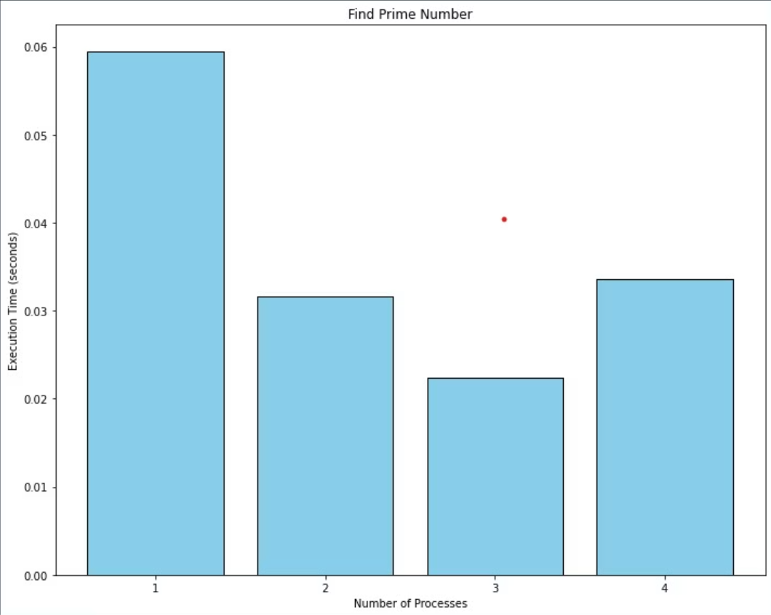
Execute Time Vs Number of Process

Slide 5
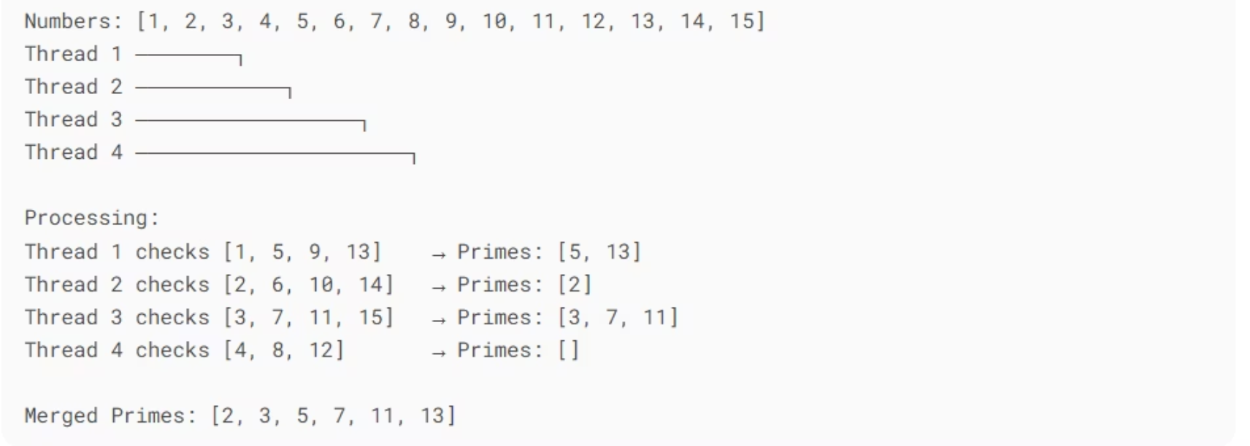
Example of Parallel Prime Number Finding

Slide 6

Parallel Searching
Linear Search
Parallel Search
Checks elements one by one, costly for large data sets.
Splits database among processors to search at the same time.
Example
Search 1 billion records with 64 processors, cutting time by 90%.

Slide 7
Steps Of Parallel Quick Search
Input Broadcast: The main process reads a list of numbers from a file and gets the number to search for (the target). It then sends the entire list and the target number to all other processes.
Local Search: Each process receives the list and the target. It searches for the target within a specific portion (chunk) of the list assigned to it. If a process finds the target, it records the index where it was found (relative to the entire list).
Result Collection: Each process sends back the index where it found the target (or -1 if not found in its chunk) to the main process.
Final Output: The main process receives all the indices. It determines if the target was found by any process and, if so, at which global index and by which process. This information, along with the execution time, is written to an output file and printed to the console.

Slide 8
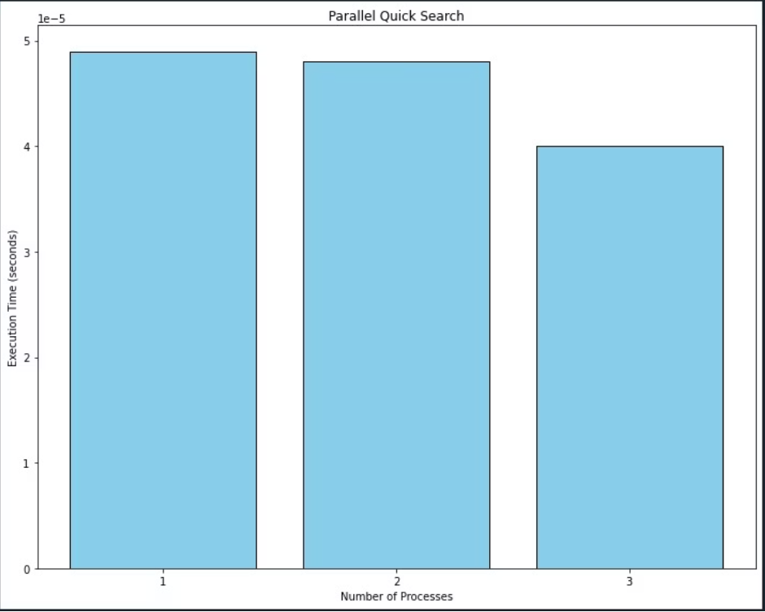
Execute Time Vs Number of Process

Slide 9
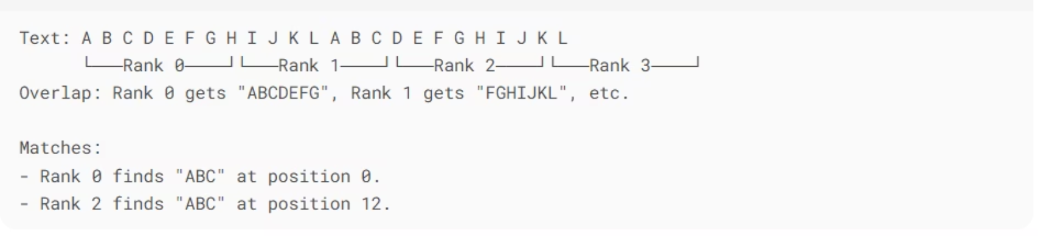
Sample Of Parallel Quick Search

Slide 10
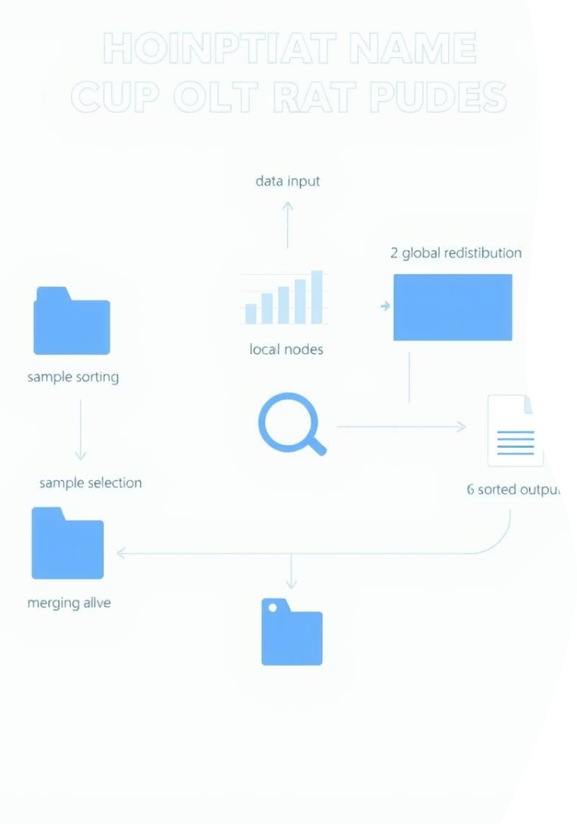
Parallel Sample Sort Algorithm
Divide Data
Distribute data and select representative samples on processors.
Local Sorting
Processors sort data subsets using quicksort or merge sort.
Merge
Sorted subsets merged efficiently, balancing load and minimizing communication.
Handles 100 million integers with near-linear speedup until communication dominates.

Slide 11
Steps Of Sample Sort
Initial Distribution and Local Sort: The main process reads numbers and distributes them equally to all processes. Each process sorts its local chunk of numbers.
Sample Selection: Each process selects a few representative numbers (samples) from its sorted chunk and sends these samples to the main process.
Global Splitter Selection: The main process receives all the samples, sorts them, and then chooses a set of "splitter" values. These splitters help to define the boundaries for different "buckets" of numbers.
Bucket Creation and Distribution: The main process broadcasts these splitter values to all other processes. Each process then uses the splitters to divide its local sorted numbers into buckets. The numbers in each bucket should fall within a specific range defined by the splitters. Each process then sends its buckets to the process that is responsible for that range.
Local Bucket Sort: Each process receives buckets of numbers from other processes. It merges these received buckets with its own corresponding bucket and then sorts the combined bucket.
Final Gathering and Output: The processes now have sorted portions of the entire dataset. The main process gathers these sorted portions from all processes. The collected data forms the final sorted list, which is written to an output file. The execution time is also printed.

Slide 12
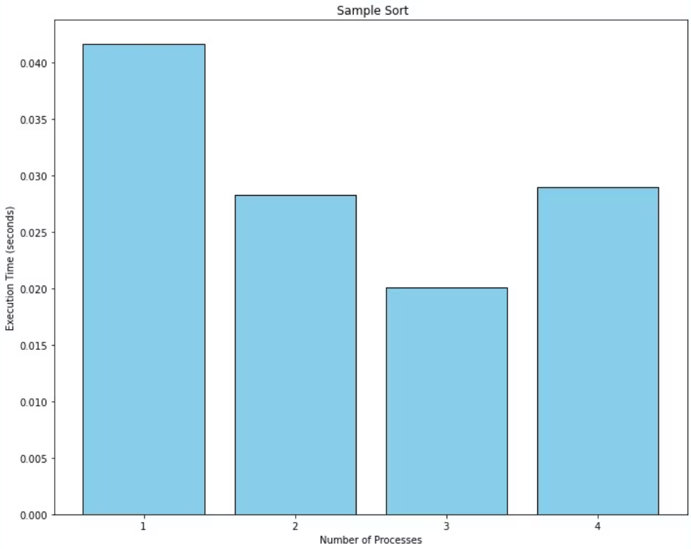
Execute Time Vs Number of Process

Slide 13
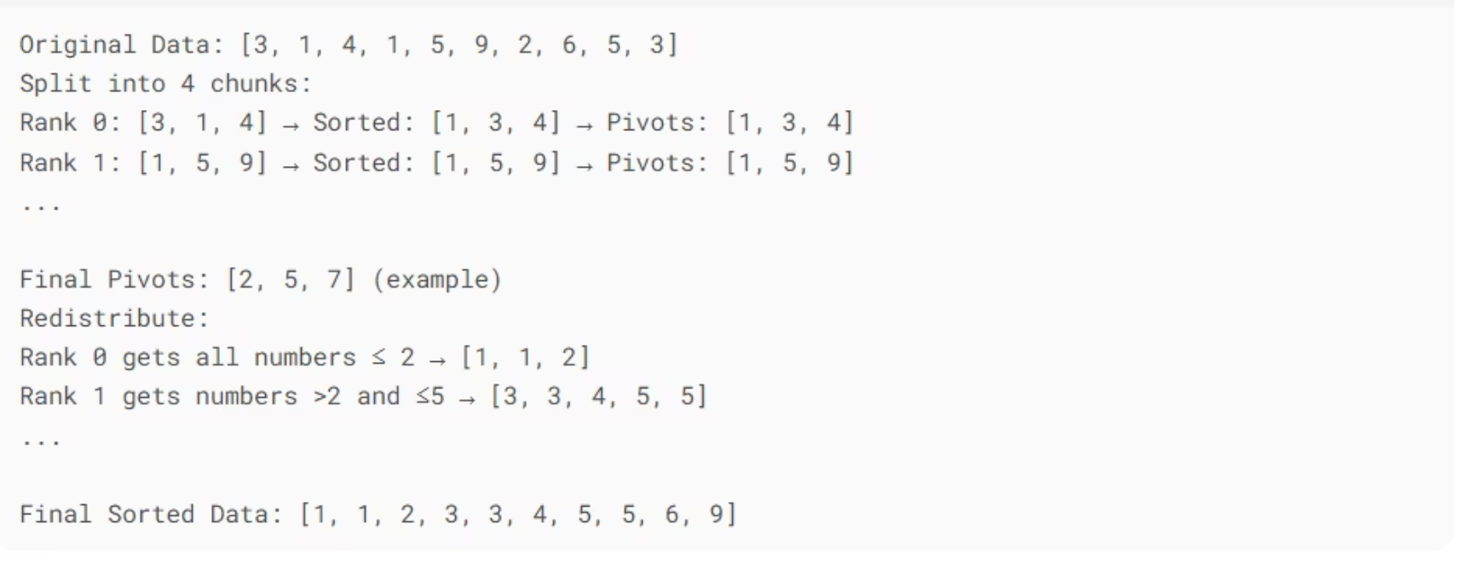
Sample Of Parallel Sample Sort

Slide 14

Parallel Radix Sort Algorithm
Principle
Implementation
Performance
Sorts data by processing digits or bits starting from the least significant to the most significant position.
Distributes keys across processors which coordinate using counting and prefix sums to sort in parallel.
Highly efficient and stable for large datasets; achieves up to 8× speedup on 10GB of data.

Slide 15
Steps Of Radix Sort Algorithm
Initial Distribution: The main process reads numbers from a file. It divides these numbers into equal-sized segments and sends one segment to each process.
Local Radix Sort: Each process receives its segment and performs a standard radix sort algorithm on its local numbers. Radix sort works by sorting the numbers digit by digit, from the least significant to the most significant.
Global Gathering: All the processes send their sorted segments back to the main process.
Final Output: The main process receives all the sorted segments, which are now in the correct order. It writes the completely sorted list of numbers to an output file and prints the execution time.

Slide 16
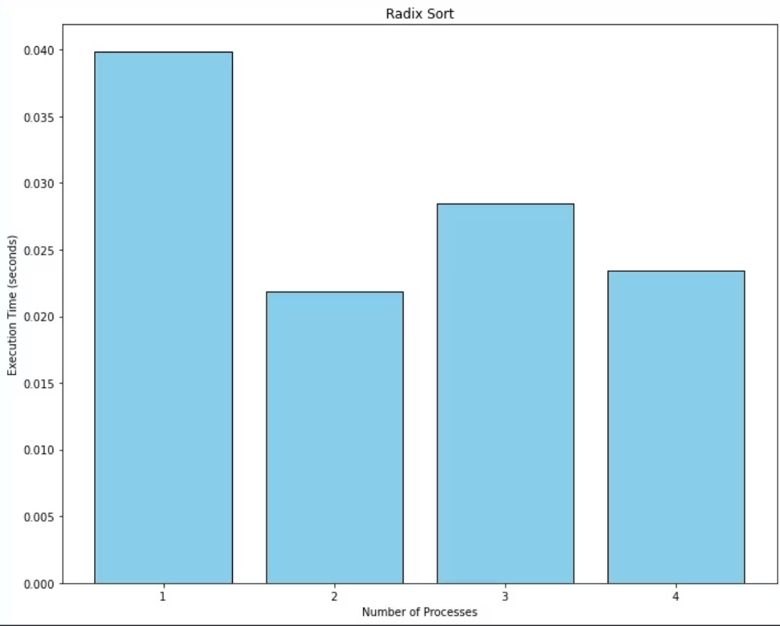
Execute Time Vs Number of Process

Slide 17
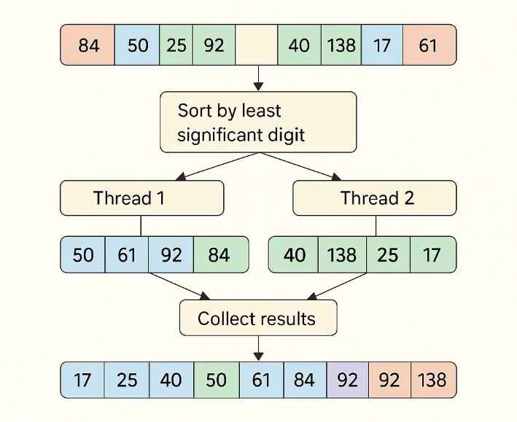
Example Of Parallel Radix Sort Algorithm

Slide 18

Parallel Bitonic Sort Algorithm
Algorithm
Network
Uses compare-and-exchange steps arranged in bitonic sequences.
Efficient on hypercube or butterfly topologies with regular communication.
Example
Sorting on 64-node hypercube demonstrates reliable and predictable patterns.

Slide 19
Steps Of Parallel Bitonic Sort Algorithm
Input Distribution: The main process reads numbers from a file and distributes them evenly among all the processes. The number of processes must be a power of 2 for this algorithm.
Local Sort: Each process initially sorts its local chunk of numbers.
Bitonic Merging: The processes then go through a series of comparison and exchange steps in a specific pattern. These steps are designed to gradually merge the sorted chunks into larger sorted sequences, following the principles of a bitonic sequence. Processes communicate with "partner" processes in each step to compare and potentially swap their data to achieve the sorted order.
Final Gathering (Implicit): After the merging steps, the sorted data is distributed across the processes. The main process gathers the final sorted segments from all other processes.
Final Output: The main process combines the received sorted segments and writes the final sorted list to an output file. It also prints the execution time.

Slide 20
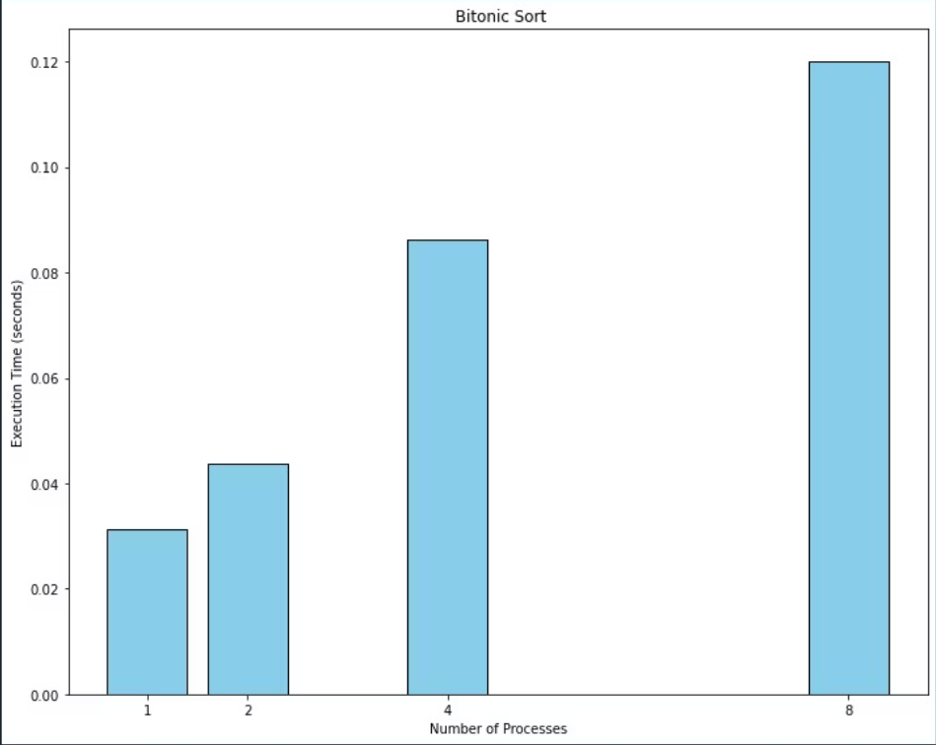
Execute Time Vs Number of Process

Slide 21
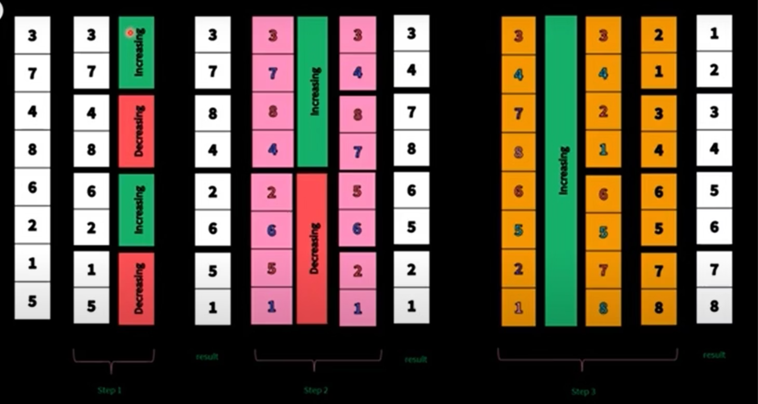
Example Of Parallel Bitonic Sort Algorithm

Slide 22
Thank You

